Slide 1
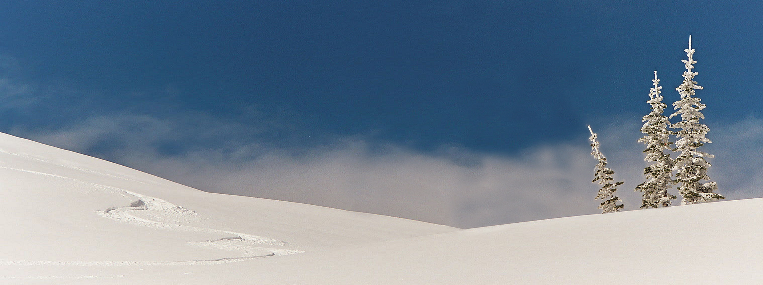
4th Grade Ski Information Presentation
Notes:
Rachael
Explain purpose of ski presentation and go over proper audience behavior
Take a survey of students who have skied before
This is a school fieldtrip
School expectations apply
We are so fortunate to work with the community to provide you with this experience.
It isn’t a “free day”. It is to encourage you to start skiing – expose you to a life-long hobby or activity you might love living in Montana.

Slide 2
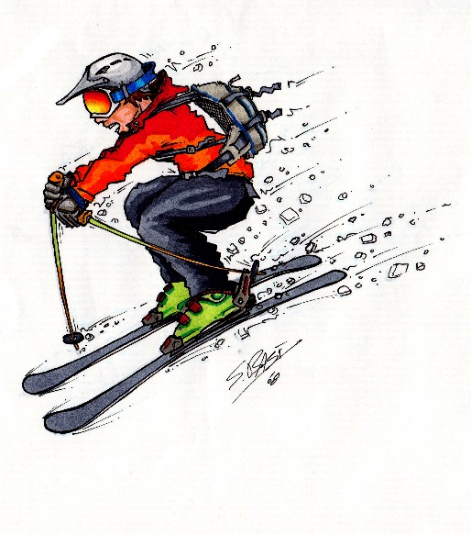
What to Wear
To make this the best day ever, you want to stay warm and dry.
Dress in three layers:
First Layer
Intermediate layer
Outer layer
Pack your bag the morning before
Notes:
Barbi
Allows for continual change in body temperature – layers helps you add or take off
If you need any of the winter gear mentioned today, please notify your teacher as soon as possible so we can get you the items before your ski day.
Pack bag the morning before to ensure you have everything you need.

Slide 3
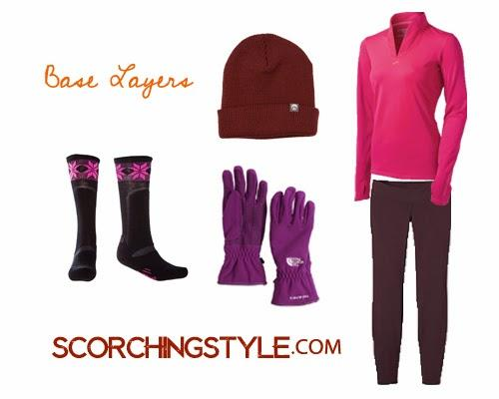
First Layer
Purpose: To keep water off your skin and keep you dry.
Long underwear (Tops and Bottoms)
One layer of socks (Put on first)
Notes:
Barbi
Socks: Go on first. One pair
Long underwear keep them up.
No ankle socks – want them to come over shin to protect you from the boot

Slide 4
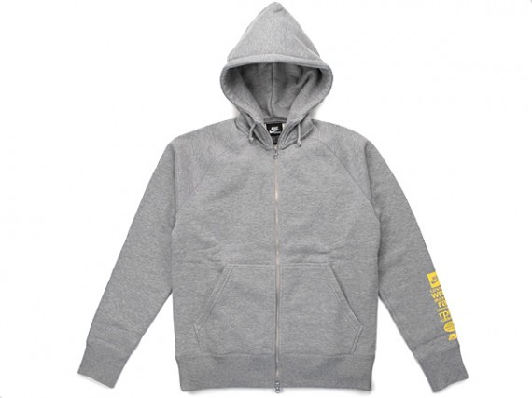
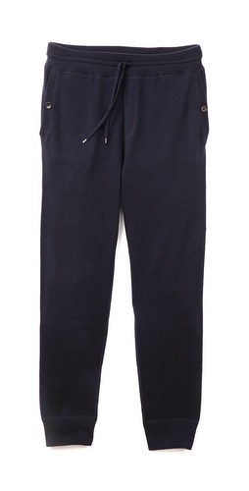
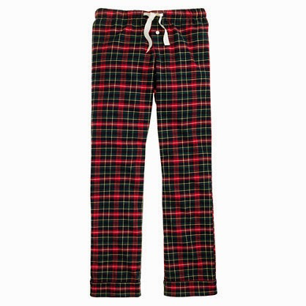
Intermediate Layer
Purpose: trap the heat like an envelope.
Fleece, sweats, sweatshirts
Notes:
Barbi

Slide 5
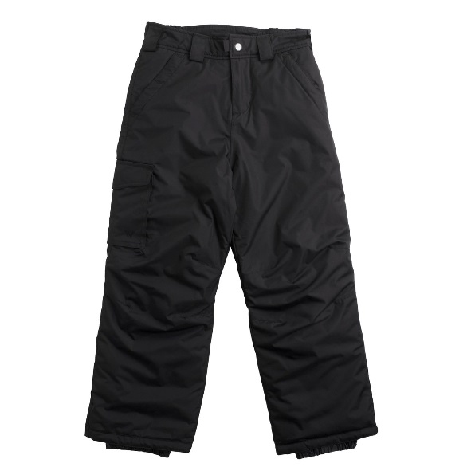
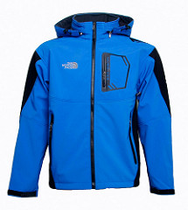
Outer-layer
Purpose: to repel wind and water
Coat
Snow pants
Notes:
Barbi
The sound of scratching will tell you if it is waterproof
As a skier, you create wind, so you want it to be wind proof (this is an odd rationale…)

Slide 6
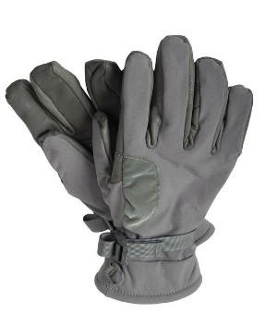
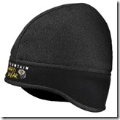
Extra Clothing
Gloves
Mittens are warmer than gloves
No knit gloves or mittens
Hats
Must cover ears
Keep in 40% of your body heat
Scarf/Gator/Turtleneck
Keeps neck warm
Loose ends tucked in
Goggles and sunglasses
Protect the eyes from sun’s reflection and brightness at higher elevation
Helmet (if you have one – not required)
Only ski helmets, no bike or motorcycle helmets
Notes:
Barbi

Slide 7
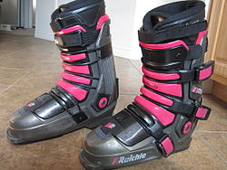
Boots should be tight.
Push out tongue of boot before you put foot in.
Point toe and put all weight on foot.
Snap the clasps tightly.
You should be leaning forward and not be able to move your foot.
You will walk heel to toe and take steps one at a time.
Notes:
Someone will be able to help you with these. However, these are things to know about boots. Again, why it is also important to only wear one pair of socks!

Slide 8
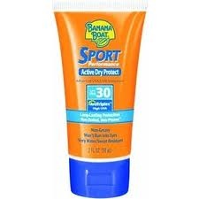
Sun Safety on Slopes
To ensure you have a safe and fun day on the slopes, remember these tips to protect you from the sun and its radiation.
Wear the protective clothing mentioned before.
Apply generous amounts of sunscreen on exposed skin. (30 or more SPF)
It’s not the heat of the sun that causes skin damage but radiation from the sun.
Notes:
Barbi

Slide 9
Questions?

Slide 10
What to Expect
You will get your boots in the basement of the lodge.
If you have your own equipment, you are allowed to bring it.
Chaperone or teacher will put lift ticket on your coat.
You will be grouped according to your ski level.
You will locate your skis outside. (No poles)
Regardless of ability level, everyone takes a lesson. You will stay with your designated group for the day.
Follow the "Your Responsibility Code," the seven safety rules of the slopes:
Notes:
It is important that you are honest about your level and go with the right group.
The best way to become a good skier or snowboarder is to take a lesson from a qualified instructor.
You can only snowboard if you have your own equipment.
You will get your skis after outside – but no poles

Slide 11
Responsibility Code
Always stay in control.
People ahead of you have the right of way.
Stop in a safe place for you and others.
Whenever starting downhill or merging, look uphill and yield.
Use devices to help prevent runaway equipment.
Observe signs and warnings, and keep off closed trails.
Know how to use the lifts safely.
Notes:
Responsibility code for all skiers on the mountain – like driving on the roads. We all follow the rules.
If you are out of control – sit down.
2. Keep your eyes forward. (If you are going by someone – go wide and say “on your right, on your left.” Just like bikers on the River’s Edge Trail.
Don’t stop – or stop to the side of the run.
Be scanning and looking – just like when I am driving or biking – looking around and watching for cars. When you are skiing – watch for other skiers and trees.
You might see the pegs come down on skis when you step out of them. These help the equipment from sliding away. Keeps the skis in the snow. If snowboarding – use the straps.
Stay in all designated areas. (Shaded areas. If many experienced skiers – share map with shaded areas you to slow designated areas. Watch for all MAPs and signs. Read!).Chair lift three takes you to slow runs for new skiers. Deep snow can be dangerous and tree wells can cause accidents. We need to know you are safe.
You probably will not be going on the chair lift. You will be taught how to use it only when you are ready. (which probably wont be today in the short amount of time we have on the hill)

Slide 12
Beginner Mountain
Magic carpet
https://www.youtube.com/watch?v=3KUqIowgxn0
Learn to stop and turn
Notes:
The purpose for the Beginner Mountain is to teach you the fundamentals of skiing. Specifically, you will be learning how to turn and stop. This takes TIME and you will most likely be practicing these skills the entire time you are up at Showdown.

Slide 13
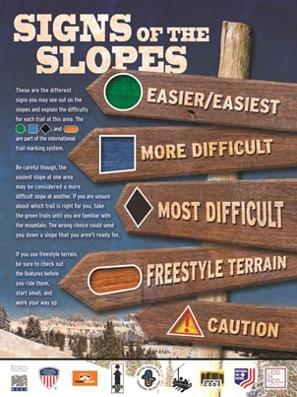
Trail Signage
You’ve arrived. You’re geared up and have a lift ticket. Now what? Go get a trail map at the base lodge or lift-ticket window. Take a few minutes to check it out. The lifts and the trails are marked on the map. The colored symbols next to the trails are the keys to enjoying your first few days on the slopes. Their shape and color indicate the difficulty of the trail.
Here’s what they mean:
Blue Square: More Difficult Black Diamond: Most Difficult Double-Black Diamond: Most Difficult, use extra caution Orange Oval: Freestyle Terrain.
Here’s what they mean:
Green Circle: Easier Blue Square: More Difficult Black Diamond: Most Difficult Double-Black Diamond: Most Difficult, use extra caution Orange Oval: Freestyle Terrain
Notes:
For students who have skied before

Slide 14
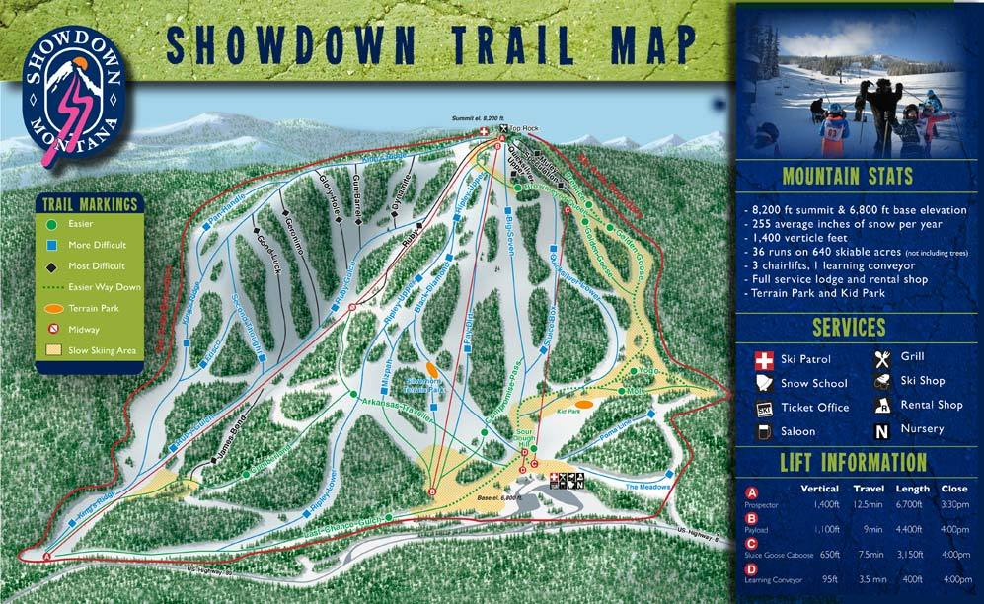
Notes:
Point out the green and blue symbols as these are the runs that experienced skiers will be using.
Show students the ski area boundary

Slide 15
Injury Prevention
Always ski with a group.
If you are injured, yell for help. Do not move or take skis off.
If you are with someone who is injured, take your skis off and make an X. Stay with injured.
Send other people to find ski patrol (red vest with white cross), chair lift operator or other adult.
Notes:
Barbi

Slide 16
How to End Your Day Successfully
Go to the basement, put your shoes on.
Take both boots and skis back to rental shop at the designated time.
This is your responsibility!
Take off wet clothing and prepare for the ride home.
Notes:
Rach
The basement is located in the lodge, which is a separate building from the rental shop.
Remind teachers to sweep the basement and the ski racks to make sure all of the materials are returned at day’s end.

Slide 17
Other Items
Eat a good breakfast. You will use a lot of energy physically and also to stay warm.
Pack a good lunch and snacks.
Bring a water bottle. It is important to stay hydrated.
Use restroom before boarding the bus home.
Notes:
Barbi
A snack will be provided for you during the bus ride to Showdown.

Slide 18
Snowbird Tile
Notes:
Barbi
A mystery staff member at Showdown will have this tile in their possession! Your job is to politely ask people for the tile. “Hi, my name is Rachael (I’m dying), do you have the tile?”
If you find the person with the tile, you win a free day pass to Showdown!

Slide 19
Questions?
Notes:
Rach
Tell students you only need QUESTIONS at this time, no stories please.

